Slide 1
Mobile Application Development
React Native
Pranav Walunj
MCA

Slide 2
Introduction:
React Native lets you build mobile apps using only JavaScript. It uses the same design as React, letting you compose a rich mobile UI from declarative components. With React Native,
you don't build a mobile web app, an HTML5 app, or a hybrid app; you build a real mobile app that's indistinguishable from an app built using Objective-C or Java.
React Native uses the same fundamental UI building blocks as regular iOS and Android apps. You just put those building blocks together using JavaScript and React

Slide 3
React Native Features
Following are the features of React Native −
React − This is a Framework for building web and mobile apps using JavaScript.
Native − You can use native components controlled by JavaScript.
Platforms − React Native supports IOS and Android platform.

Slide 4
React Native Advantages
Follow are the advantages of React Native −
JavaScript − You can use the existing JavaScript knowledge to build native mobile apps.
Code sharing − You can share most of your code on different platforms.
Community − The community around React and React Native is large, and you will be able to find any answer you need.

Slide 5
React Native Limitations
Native Components − If you want to create native functionality which is not created yet, you will need to write some platform specific code.

Slide 6
Step to how to Run
npm install -g create-react-native-app
create-react-native-app MyReactNative
npm install -g react-native-cli
cd MyReactNative
npm start
react-native run-android

Slide 7
What is Intents
Android Intent is the message that is passed between components such as activities, content providers, broadcast receivers, services etc
An Android Intent is an abstract description of an operation to be performed. It can be used with startActivity to launch an Activity, broadcastIntent to send it to any interested BroadcastReceiver components, and startService(Intent) or bindService(Intent, ServiceConnection, int) to communicate with a background Service.

Slide 8
Android intents : Use
Start the service
Launch an activity
Display a web page
Display a list of contacts
Broadcast a message
Dial a phone call etc.

Slide 9
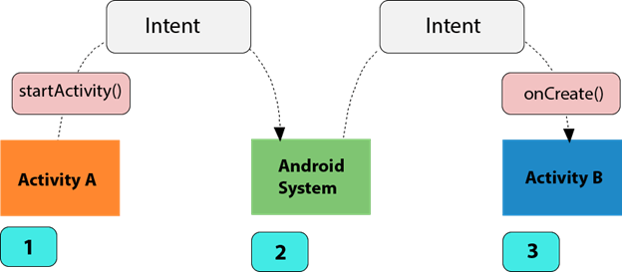
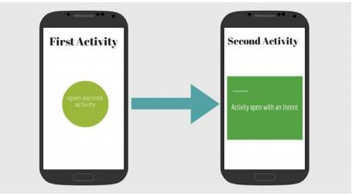

Slide 10
Types of Android Intents
Implicit Intent
Implicit Intent doesn't specifiy the component. In such case, intent provides information of available components provided by the system that is to be invoked.
Intent intent=new Intent(Intent.ACTION_VIEW);
intent.setData(Uri.parse("http://www.javatpoint.com"));
startActivity(intent);

Slide 11
Explicit Intent
Intent i = new Intent(getApplicationContext(), ActivityTwo.class);
startActivity(i);
Android Implicit Intent Example
activity_main.xml
MainActivity.java

